Slide 1
Power Electronics
Seminar #2
Part 1
Reporter
NIE YONGXIN
：
CHANG YI
WANG DAOXI
：
：

Slide 2
division of work
NIE YONGXIN:
Carry out the simulation.
The part 2 of PPT.
The images of part 2.
The analysis of the result.
CHANG YI:
The information searching.
Carry out the simulation.
The analysis of the result.
The theoretical calculations of the part 1
WANG DAOXI:
Carry out the simulation.
The part 1 of PPT.
The analysis of the result.

Slide 3
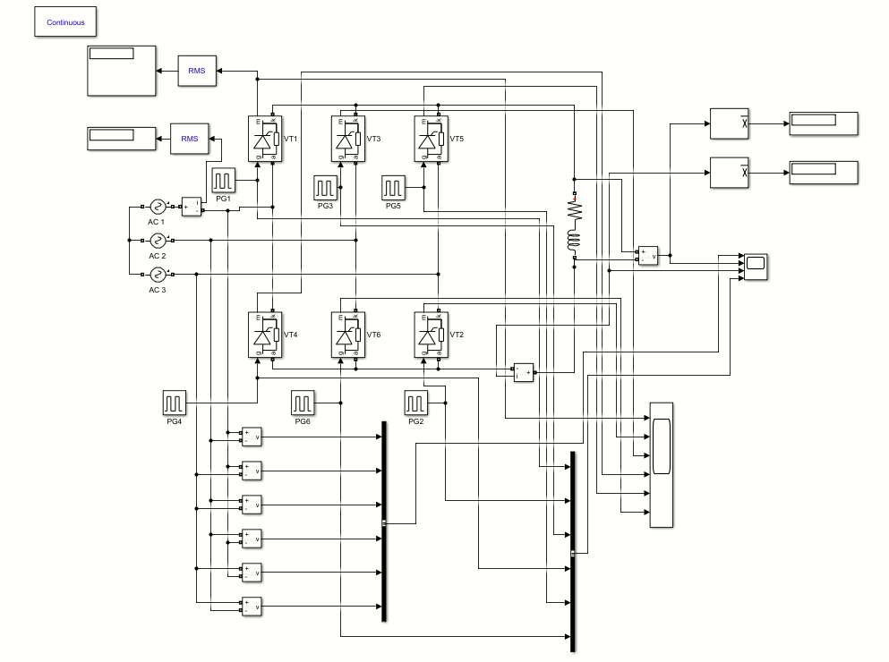
Circuit 1

Slide 4
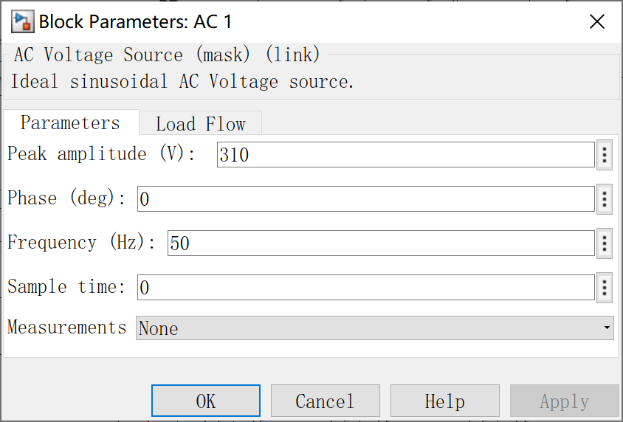
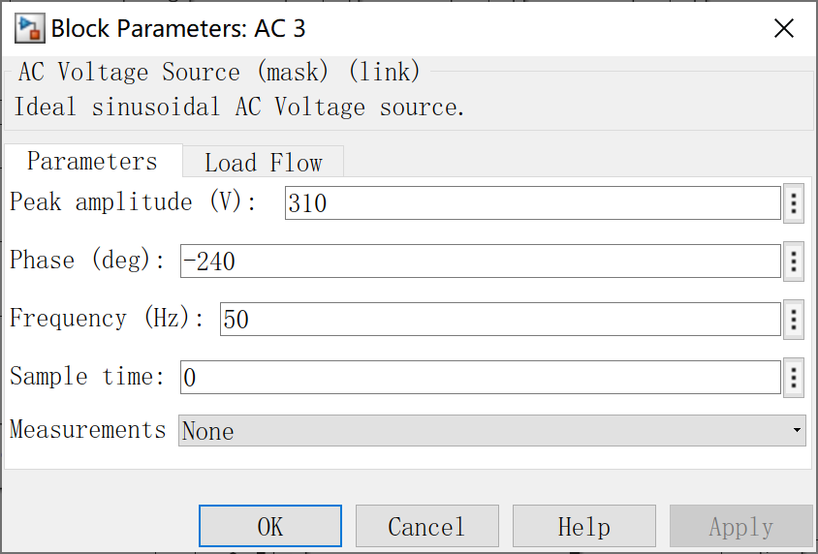

Parameter Setup
Resistor and inductor
Power Supply
L | R | α₁
5mH | 1Ω | 85°

Slide 5
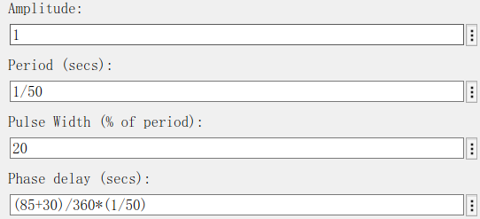
Parameter Setup
Pulse setting
a=85; f=50; T=1/f; VT1=(a+30)/360*T VT2=(a+30+60)/360*T VT3=(a+30+120)/360*T VT4=(a+30+180)/360*T VT5=(a+30+240)/360*T VT6=(a+30+300)/360*T

Slide 6
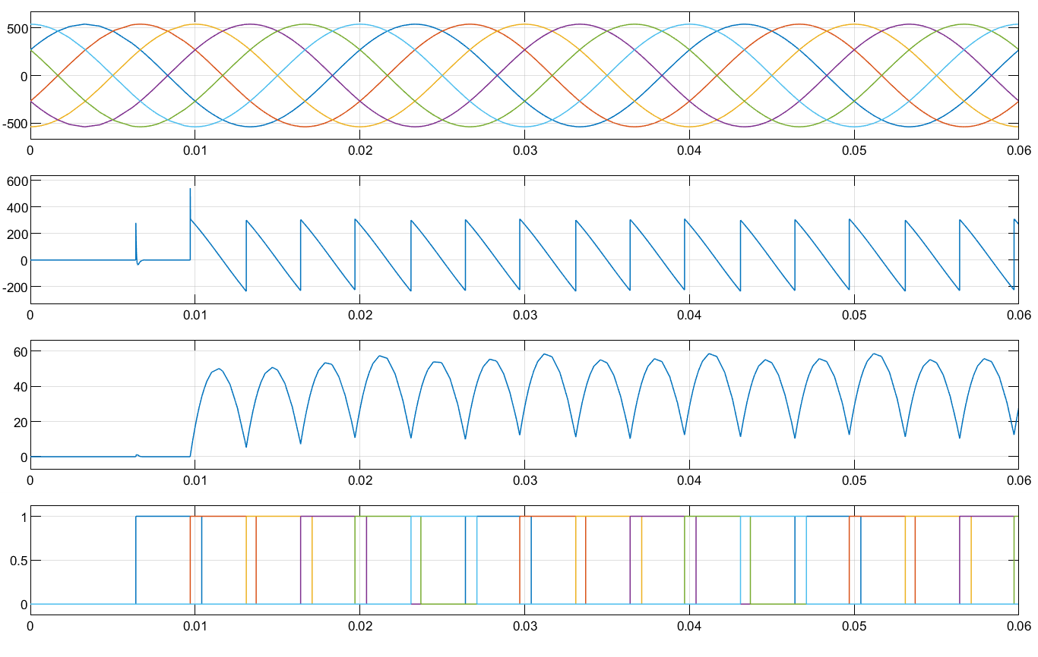
Waveform of circuit 1

Slide 7
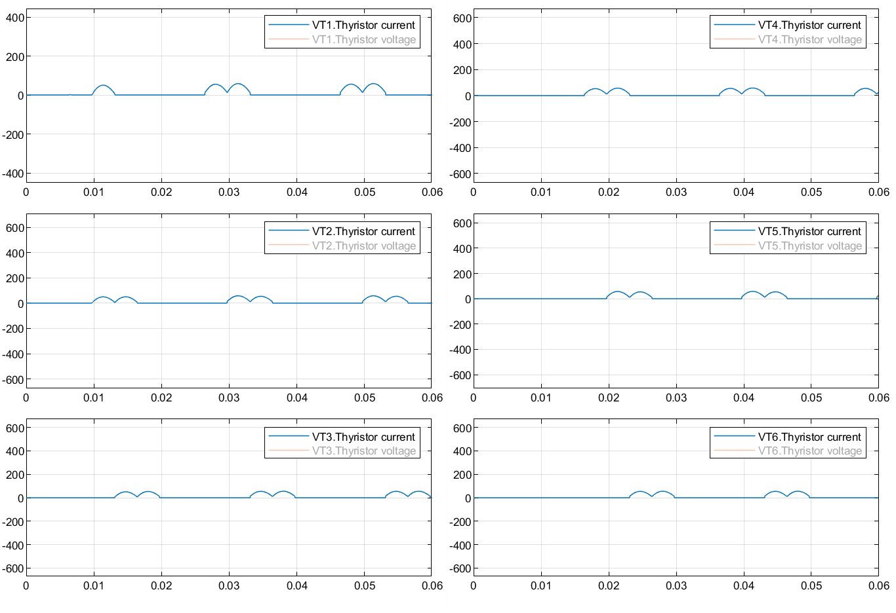
Current through Thyristors

Slide 8




Simulation Result
 | Rectification Mode
 | theoretical results | simulation results | deviation
U_{d} | 44.87V | 42.31V | 5.71%
I_{d} | 44.87A | 40.87A | 8.91%
I₂ | 36.64A | 33.92A | 7.42%
I_{VT} | 25.91A | 28.46A | 9.84%
$$u_{d}=2.34u_{2}\cos{α}$$
$$I_{d}=\frac{u_{d}}{R}$$
$$I_{VT}=\frac{I_{d}}{\sqrt{3}}$$
$I_{2}=\sqrt{2}$ $I_{VT}$

Slide 9
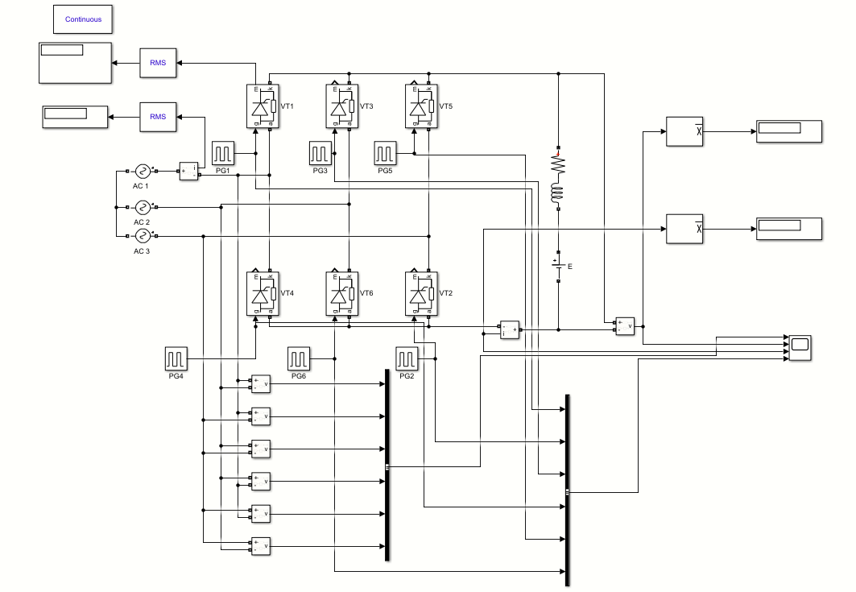
Circuit 2

Slide 10
Parameter Setup
Power Supply
L | R | E | α2
5mH | 1Ω | -400V | 170°

Slide 11
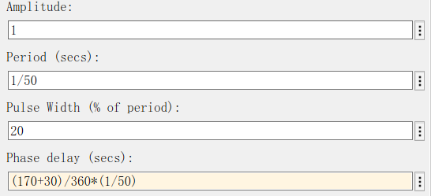
Parameter Setup
Pulse setting
a=170; f=50; T=1/f; VT1=(a+30)/360*T VT2=(a+30+60)/360*T VT3=(a+30+120)/360*T VT4=(a+30+180)/360*T VT5=(a+30+240)/360*T VT6=(a+30+300)/360*T

Slide 12
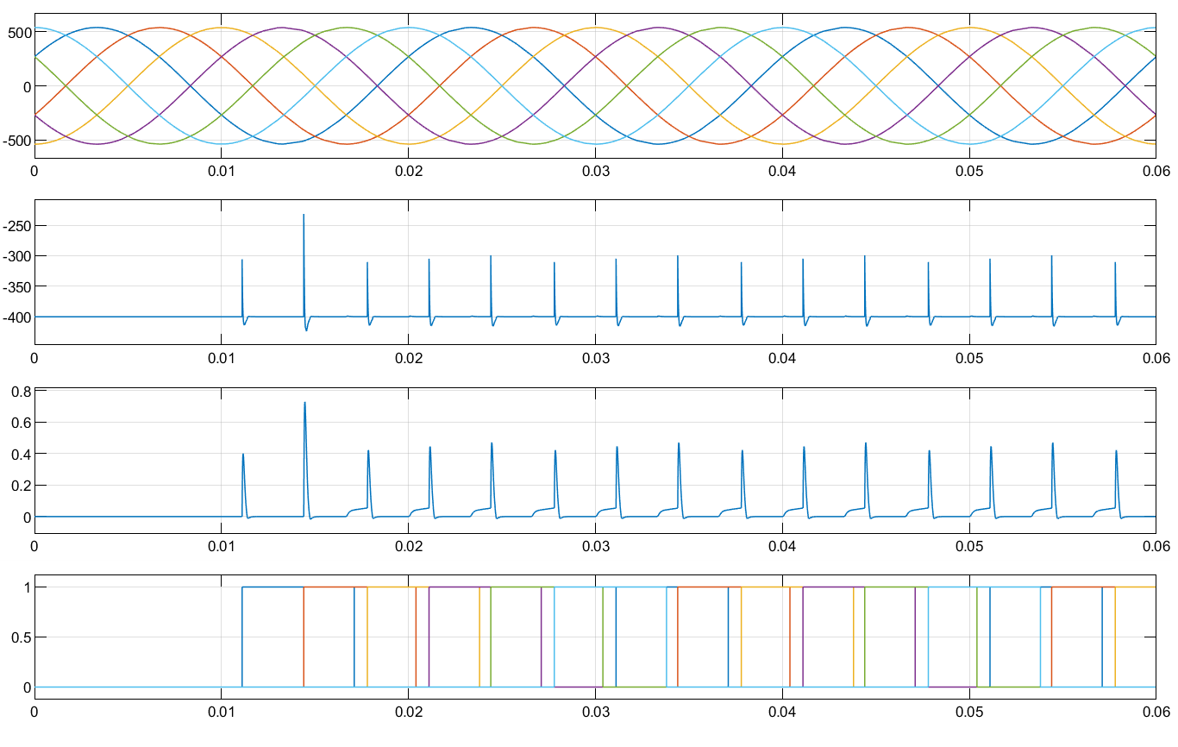
Waveform of circuit 2

Slide 13
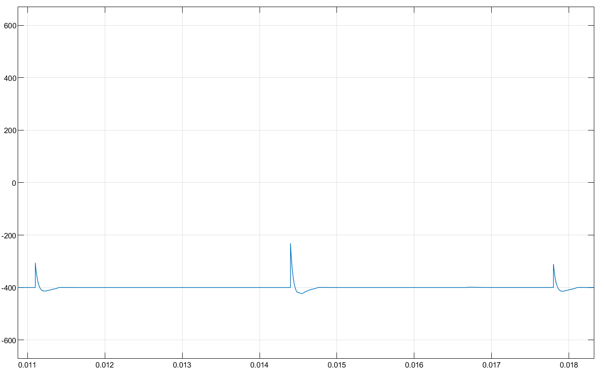
Waveform of Ud

Slide 14
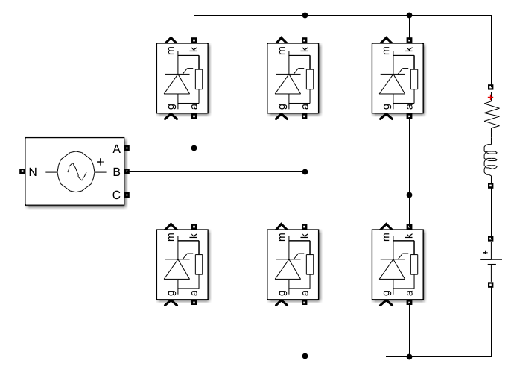




Simulation Result
 | Active Inversion Mode
 | theoretical results | simulation results | deviation
U_{d} | -506.98V | -400V
I_{d} | -106.98A | 0.03187A
I₂ | -87.39A | 0.07383A
I_{VT} | -61.76A | 0.07439A
$$u_{d}=−1.35u_{2l}\cos{β}$$
$$I_{d}=\frac{u_{d}−E_{m}}{R}$$
$$I_{VT}=\frac{I_{d}}{\sqrt{3}}$$
$I_{2}=\sqrt{2}$ $I_{VT}$

Slide 15
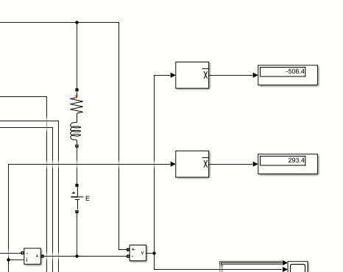
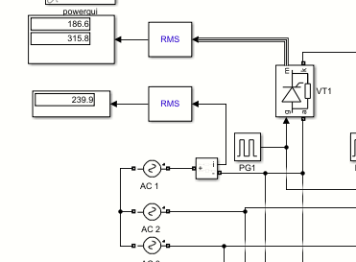
Simulation Result
E=-800V
simulation results of U_{d} and I_{d}
simulation results of I_{VT} and I₂

Slide 16
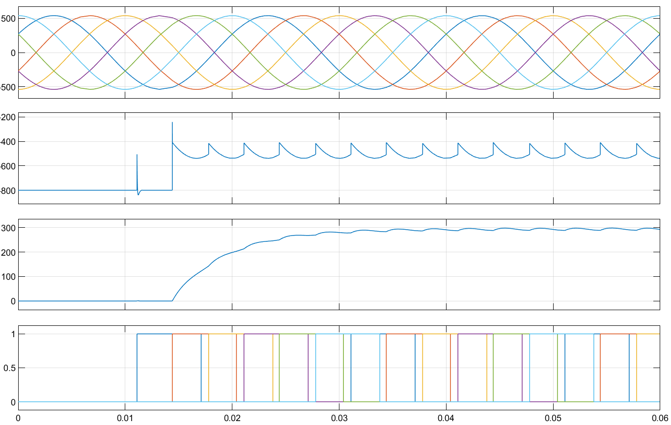
Waveform
E=-800V

Slide 17
Your Questions and Comments are welcome

